Slide 1
Change & paradigms
Balance Life Coach Training

Slide 2
Change
True change comes from within
Change is a guaranteed constant
Change happens when the pain exceeds the pleasure

Slide 3
Change
C = D x V x F > R
C = Change
D = Dissatisfaction with status quo
V = Vision of what can be
F = First concrete steps towards the vision
R = Resistance to change

Slide 4
Paradigm
A model, a pattern or a frame of reference
The way we think about things
Our maps that describe the territory
A paradigm shifts when we see things differently

Slide 5
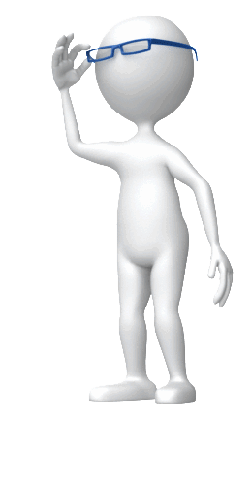
Paradigm
Glasses we use to see

Slide 6
Paradigm
As a man thinks so is he

Slide 7

Paradigm
What really matters is not what you look at, but how you see

Slide 8
Count the f’s
Feature films of chimpanzees, of dolphins and of elephants are the result of years of scientific research combined with years of experience

Slide 9
Count the f’s
Feature films of chimpanzees, of dolphins and of elephants are the result of years of scientific research combined with years of experience

Slide 10


Slide 11
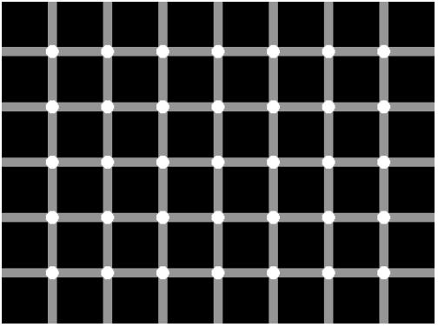

Slide 12
Join the 9 dots

Slide 14
IX

Slide 15
SIX

