Slide 1
The 24 character strengths
Wisdom and Knowledge
Courage
Humanity
Justice
Temperance
Spirituality and transcendence

Slide 2
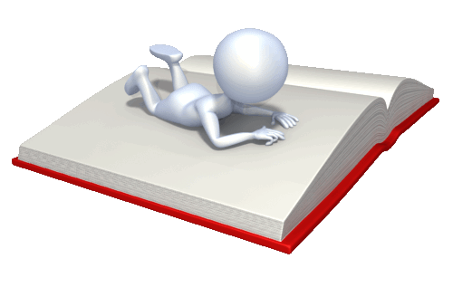
The 24 character strengths
Wisdom and Knowledge
cognitive strengths that entail the acquisition and use of knowledge

Slide 3
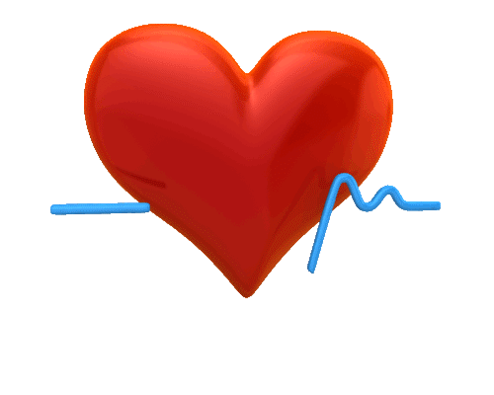
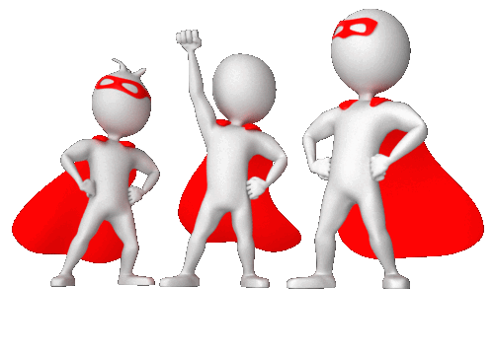
The 24 character strengths
2. Courage
emotional strengths that involve the exercise of will to accomplish goals in the face of challenge

Slide 4
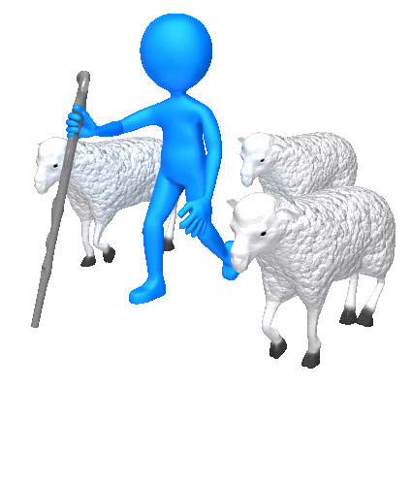
The 24 character strengths
3. Humanity
interpersonal strengths that involve tending and befriending others

Slide 5
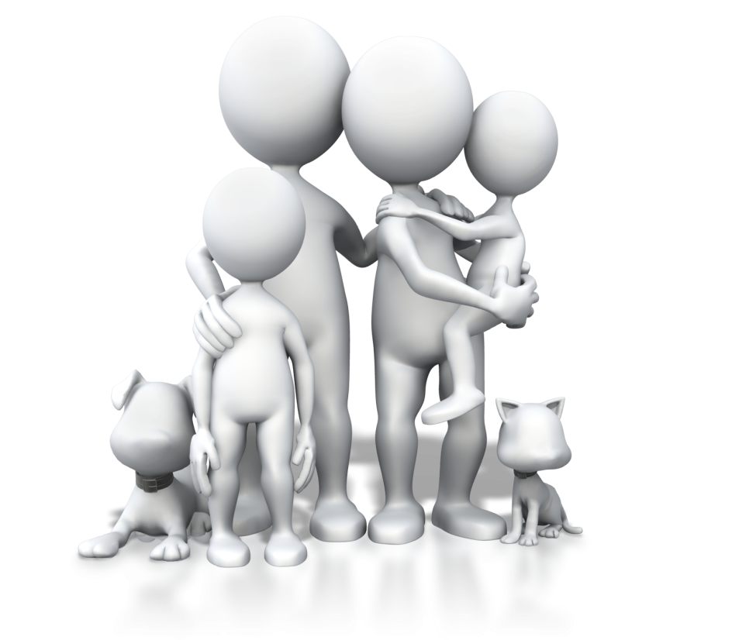
The 24 character strengths
4. Justice
social strengths that underlie healthy community life

Slide 6

The 24 character strengths
5. Temperance
strengths that protect against excess

Slide 7


The 24 character strengths
6. Transcendence
spiritual strengths that forge connections to the larger universe and give meaning

Slide 8
The 24 character strengths
1. Wisdom and Knowledge - cognitive strengths that entail the acquisition and use of knowledge

Slide 9
1. Wisdom & knowledge
Creativity
Curiosity
Open-mindedness
Love of learning
Perspective (wisdom)

Slide 10
creativity
A creative person is someone who comes up with ideas that are original and useful
Creativity includes artistic achievement, but is not limited to it
People who are creative enjoy thinking of novel and productive ways to describe and do things
People with this strength show sparks of ingenuity

Slide 11
creativity
Descriptive words
Original, ingenious
Too much
Odd, weird
Too little
Dull, conforming

Slide 12
curiosity
Curious people have a keen interest in their own experiences and the world around them
They are attracted to new things, people, and experiences
They are rarely bored
They are good listeners and conversationalists
They ask questions from new and different perspectives
They like to explore and discover

Slide 13
curiosity
Descriptive words
Interested, novelty-seeking, openness to new experiences
Too much
Prying, snooping, nosey
Too little
Bored, disinterest, apathy

Slide 14
Open-mindedness
Open-minded people are critical and broad thinking people
They love to think things through and examine them from all sides
They don’t jump to conclusions too quickly
They are able to change their minds in the light of new evidence
They can integrate previous knowledge & experience with new knowledge & experience

Slide 15
Open-mindedness
Descriptive words
Critical thinkers, judgment
Too much
Cynical, sceptical
Too little
Dogmatic, unaware, rigid

Slide 16
Love of learning
People that love learning frequently masters new skills, topics, and bodies of knowledge
They learn by themselves or through a formal process of instruction
This strength is related to the strength of curiosity
These people are eager to share what they learn with others

Slide 17
Love of learning
Descriptive words
Student of life
Too much
A know-it-all, arrogant
Too little
Complacent, self-righteous, smug

Slide 18
perspective
People with perspective are often perceived as people with wisdom
They are able to get inside someone else’s point of view (paradigm)
They have insight beyond the facts
They are able to give sound guidance
They can explain reasons in a way that makes sense to themselves and other people
They have ways of looking at the world that makes a lot of sense

Slide 19
perspective
Descriptive words
Wisdom, insightful
Too much
Pedantic, impenetrable, mysterious
Too little
Superficial, shallow

Slide 20
The 24 character strengths
2. Courage - emotional strengths that involve the exercise of will to accomplish goals in the face of challenge

Slide 21
2. courage
Bravery
Persistence
Integrity
Vitality/Zest

Slide 22
Bravery
Bravery is the strength of not shrinking from threat, challenge, difficulty, or pain
These people can speak up for what is right … even in the face of opposition
They act on their convictions, even if it makes them unpopular
They have a “come-what-may” attitude
This strength includes physical bravery but is not limited to it

Slide 23
bravery
Descriptive words
Valour, courageous, fearless
Too much
Risk-taker, ‘show-off’
Too little
Fearful, apprehensive, timid

Slide 24
Persistence/perseverance
People with this strength are industrious and have diligence & perseverance
They see things through, they finish what they start
They are persistent in a course of action in spite of obstacles
They are resilient and hopeful

Slide 25
Persistence/perseverance
Descriptive words
Persistent, tenacious, steadfast, industrious
Too much
Obsession, fixated, absorbed, fanatical
Too little
Slack, lazy, slow, lifeless

Slide 26
integrity
People with this strength are authentic, genuine and honest
They speak the truth but more broadly present themselves in a genuine way and act in a sincere and considerate way
They are without pretence (WYSIWYG)
They often take responsibility for their feelings and actions

Slide 27
integrity
Descriptive words
Honest, authentic, genuine, real
Too much
Self-righteous, pretentious, pompous
Too little
Shallow, phony, fake, false

Slide 28
Vitality, ZEST
People with this strength have enthusiasm and vigour
They approach life with excitement and energy
They don’t do things halfway or half-heartedly
They live life as an adventure
They often participate in risky activities

Slide 29
Vitality/zest
Descriptive words
Enthusiastic, vigorous, energetic
Too much
Hyperactive, agitated, restless, manic
Too little
Passive, inhibited, withdrawn, subdued

Slide 30
The 24 character strengths
3. Humanity - interpersonal strengths that involve tending and befriending others

Slide 31
3. Humanity
To love, and to be loved
Kindness
Social intelligence

Slide 32
To Love, TO BE LOVED
People with this strength love and allow themselves to be loved
They deeply value close relationships with others
They appreciate it when people reciprocate their love by sharing and caring
They love being close to people
They are comfortable at expressing affection in words, acts and touch

Slide 33
To Love, TO BE LOVED
Descriptive words
Compassionate, caring, people-centred
Too much
Overbearing, emotionally dependant, draining
Too little
Isolated, detached, withdrawn, disconnected

Slide 34
kindness
People with this strength are generous, compassionate and caring
They love to do favours and good deeds for others
They are a pleasure to be around
They try to help other people in a concrete and real way
They are nurturing

Slide 35
kindness
Descriptive words
Generous, nurturing, altruistic, nice
Too much
Intrusive, invasive, pushy
Too little
Indifferent, uncaring, apathetic

Slide 36
Social intelligence
People with this strength are in touch with their own values, motivations, and limitations, they know themselves
They are emotionally intelligent
They are aware of their own feelings and the feelings of others
They are discerning and can “read” people accurately
They are adaptable in various social settings

Slide 37
Social intelligence
Descriptive words
Emotionally intelligent, socially skilled
Too much
Psycho-babbling
Too little
Clueless, not in touch, naïve, ignorant

Slide 38
The 24 character strengths
4. Justice - social strengths that underlie healthy community life

Slide 39
4. justice
Citizenship/Teamwork
Fairness
Leadership

Slide 40
Citizenship/teamwork
People with this strength are socially responsible and loyal
They value the team, family and community
They work well as members of a group
They realise they need others and that everyone has a contribution to make

Slide 41
Citizenship/teamwork
Descriptive words
Socially responsible, loyal, committed and caring
Too much
Mindless follower, automatic obedience
Too little
Obtuseness, slow, dull

Slide 42
Fairness
People with this strength have a deep sense and commitment to justice
They treat all people the same according to notions of fairness and justice
They don’t let their personal feelings bias decisions about others
They give everyone a fair chance or equal opportunity

Slide 43
fairness
Descriptive words
Equity, justice, impartiality, neutral, balanced
Too much
Detached, indifferent, unsympathetic
Too little
Prejudice, biased, unfair

Slide 44
Leadership
People with this strength encourage others to get things done
They always maintain good relationships with those being led
They are inspirational and influential
They are good at organizing groups and activities
They get results through others

Slide 45
leadership
Descriptive words
Lead, trailblazer, frontrunner
Too much
Bossy, overbearing, dominant
Too little
Compliant, submissive, yielding, conforming

Slide 46
The 24 character strengths
5. Temperance – strengths that protect against excess

Slide 47
5. Temperance
Forgiveness and mercy
Humility/modesty
Prudence
Self regulation/self control

Slide 48
Forgiveness and mercy
People with this strength forgive those who have done wrong
They have a tolerance and acceptance of the shortcomings of others
They often give people a second chance
They are not vengeful and don’t hold grudges

Slide 49
Forgiveness and mercy
Descriptive words
Merciful, kind-hearted, humane, understanding
Too much
Permissive, lenient, unregulated
Too little
Merciless, heartless, ruthless, cruel

Slide 50
Humility/Modesty
People with this strength let their accomplishments speak for themselves
They don’t regard themselves as more special than what they actually are
They don’t like to be ‘one-up’ in relationships
They dislike to be the centre of attention

Slide 51
Humility/Modesty
Descriptive words
Humble, unassuming, unpretentious
Too much
Self-deprecation, self-criticism
Too little
Arrogant, superior, proud

Slide 52
Prudence
People with this strength are careful about their choices
They don’t often take risks
They don’t say or do things they might regret later
They are always aware of consequences

Slide 53
Prudence
Descriptive words
Careful, cautious, wary
Too much
Stuffiness, strict, formal, unapproachable
Too little
Merciless

Slide 54
Self-regulation [self-control]
People with this strength regulate what they feel and do
They are careful to align their choices with their actions
They are self-disciplined
They control their appetites and emotions

Slide 55
Self-regulation [self-control]
Descriptive words
Controlled, measured, meticulous, ordered
Too much
Inhibited, obsessive, pedantic
Too little
Self-indulgent, hedonistic, decadent

Slide 56
The 24 character strengths
6. Transcendence – spiritual strengths that forge connections to the larger universe and give meaning

Slide 57
6. Transcendence
Appreciation of beauty and excellence
Gratitude
Hope
Humour
Spirituality

Slide 58
Appreciation of beauty and excellence
People with this strength live with a sense of awe
They always notice aesthetics and beauty
They appreciate excellence across all domains of life including the arts, math, science, etc.
They have a sense of awareness when in nature
They love to pursue wonder in everyday, simplistic experiences

Slide 59
Appreciation of beauty and excellence
Descriptive words
Awe, wonder, admiration, respect, reverence
Too much
People pleasing
Too little
Oblivion, insensitive, unaware

Slide 60
Gratitude
People with this strength are willing to accept acts of kindness from others
They are not presumptuous people
They are constantly conscious of their “blessings”
They are aware that others are often the source of good things
They intentionally say “Thank You”

Slide 61
gratitude
Descriptive words
Thankfulness, appreciative
Too much
People pleasing
Too little
Entitlement, self-righteous

Slide 62
Hope
People with this strength always expect the future to hold promise
They believe a good future is something that can be brought about
They are optimistic in nature
They see the bad and negative as transient and short-term

Slide 63
Hope
Descriptive words
Optimistic, future-minded, expectant
Too much
Unrealistic expectations
Too little
Depressed, dejected, hopeless

Slide 64
Humor [playfulness]
People with this strength like to laugh and tease
They bring smiles to other people
They always see the light side of even difficult situations
They don’t take themselves too serious
They are playful

Slide 65
Humor [playfulness]
Descriptive words
Fun, exciting, exuberant
Too much
Frivolous, childish
Too little
Serious, grave, sombre, depressed

Slide 66
Spirituality
People with this strength have a real connection to God
They have a deep-seated set of beliefs that shape their thinking and behaviour
They believe their lives have purpose and significance
They always pursue the deeper meaning of life
They are aware of their own role in the larger scheme of things

Slide 67
Spirituality
Descriptive words
Purposeful, faith
Too much
Fanaticism, extremism, disconnected
Too little
‘Fleshly’

