Slide 1
Multiple intelligences
PersonalityMax

Slide 2
Background
The theory of Multiple Intelligences suggests we excel with different types of intelligence
A person can be number smart, word smart, people smart or picture smart
We have the following intelligences: Verbal/linguistic, Bodily/kinesthetic, Musical, Intrapersonal, Interpersonal and Naturalist

Slide 3

Verbal/linguistic intelligence
People with Linguistic intelligence love words

Slide 4


Verbal/linguistic intelligence
They enjoy reading and writing

Slide 5

Verbal/linguistic intelligence
They are often gifted at learning languages

Slide 6

Verbal/linguistic intelligence
They like to teach others what they know

Slide 7
Possible careers
Copywriter
Court Reporter
Editor
Journalist
Lecturer
Broadcaster/Newscaster
Speech Pathologist
Teacher
Translator/Interpreter
Writer

Slide 8

Intrapersonal intelligence
People with intrapersonal intelligence are good at understanding their own feelings & motivations

Slide 9
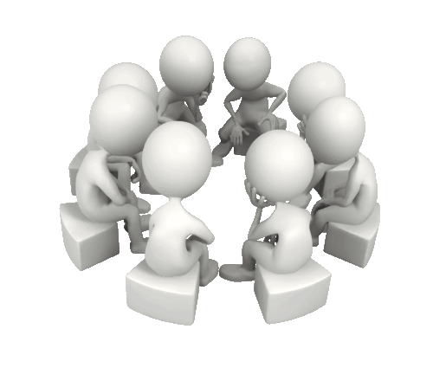
Intrapersonal intelligence
In general they are very intuitive

Slide 10

Intrapersonal intelligence
They learn independently and through reflection

Slide 11

Intrapersonal intelligence
Philosophy, psychology and theology are often of interest to them

Slide 12

Intrapersonal intelligence
They enjoy journaling because it helps them learn about themselves

Slide 13

Intrapersonal intelligence
They are also good at helping others understand themselves

Slide 14
Possible careers
Entrepreneur
Farmer
Historian
Inventor
Librarian
Philosopher
Psychologist
Scientist
Theologian
Writer

Slide 15
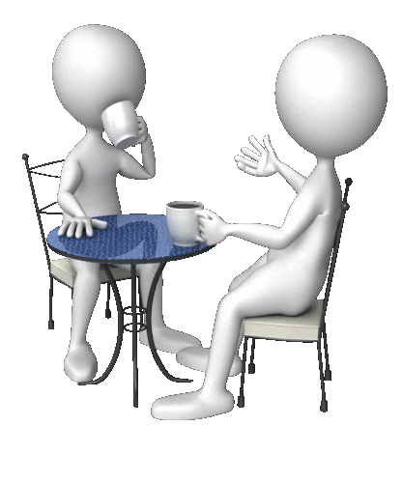
Interpersonal intelligence
People with Interpersonal intelligence thrive on social interaction

Slide 16

Interpersonal intelligence
They are gifted at establishing rapport with strangers and make friends easily

Slide 17

Interpersonal intelligence
They are good at ‘reading’, empathizing and understanding other people

Slide 18

Interpersonal intelligence
They work well with others and often have many friends

Slide 19
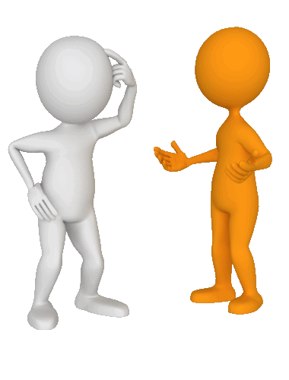
Interpersonal intelligence
They learn through interaction, dialogue and lively discussions

Slide 20

Interpersonal intelligence
In general they are enthusiastic and lively

Slide 21

Interpersonal intelligence
Others often seek them out for advice, help and comfort

Slide 22
Possible careers
Clergy
Counsellor/Life Coach
Diplomat
Politician
Public Relations
Receptionist
Sales Agent/Rep
Social Worker
Manager/Supervisor
Teacher

Slide 23

Visual/spatial intelligence
People with Visual/Spatial intelligence are very aware of their surroundings

Slide 24
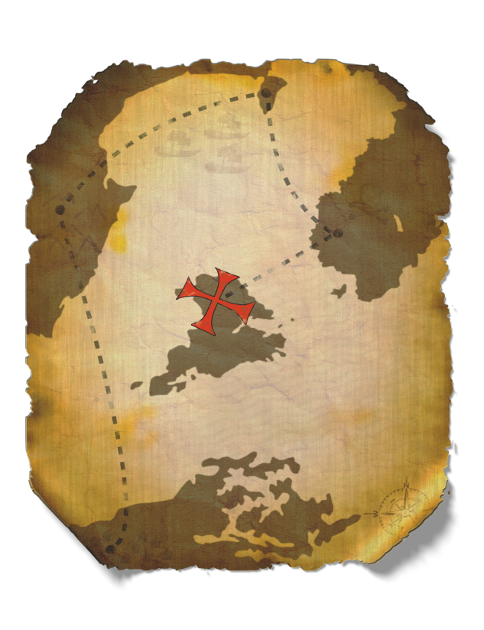
Visual/spatial intelligence
They have a keen sense of direction and often enjoy maps

Slide 25

Visual/spatial intelligence
They have a sharp sense of space, distance, logistics and measurement

Slide 26

Visual/spatial intelligence
They learn well through visual aids such as graphs, diagrams, pictures, photos and colorful displays

Slide 27

Visual/spatial intelligence
They usually enjoy visual arts such as drawing, painting and photography

Slide 28
Possible careers
Architect
Art Director
Artist
Computer Animator
Fashion Designer
Graphic Designer
Interior Decorator
Photographer
Video Editor
Web Designer

Slide 29

Bodily/kinesthetic intelligence
People with Kinesthetic intelligence learn through movement and experimentation

Slide 30
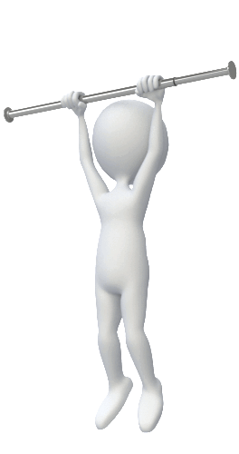

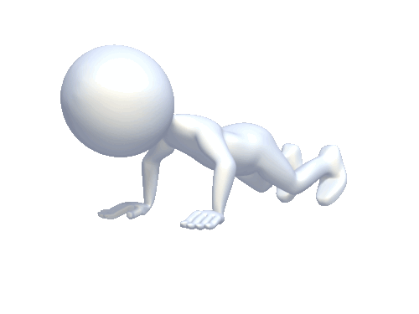
Bodily/kinesthetic intelligence
They enjoy sports and activities that require physical exertion and mastery

Slide 31

Bodily/kinesthetic intelligence
Some Kinesthetic people enjoy the artistic side of movement such as dance or any kind of creative movement

Slide 32
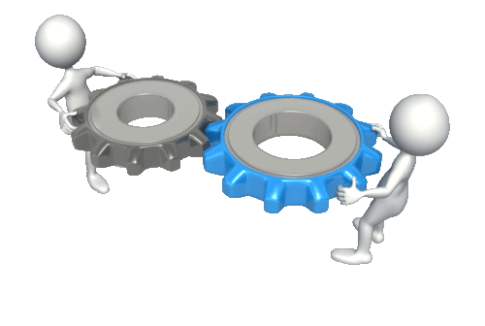
Bodily/kinesthetic intelligence
They enjoy building things and figuring out how things work

Slide 33

Bodily/kinesthetic intelligence
They have excellent motor skills and coordination (ball sense)

Slide 34
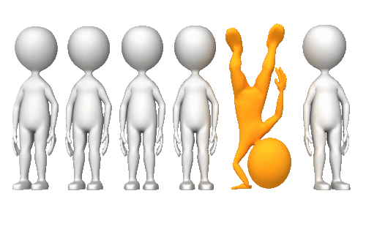
Bodily/kinesthetic intelligence
They are very physical and are keenly aware of their bodies

Slide 35
Possible careers
Actor/Actress
Athlete
Carpenter
Construction Worker
Farmer/Park Ranger
Fire-fighter
Mechanic
Paramedic
Physiotherapist
Occupational Therapist

Slide 36
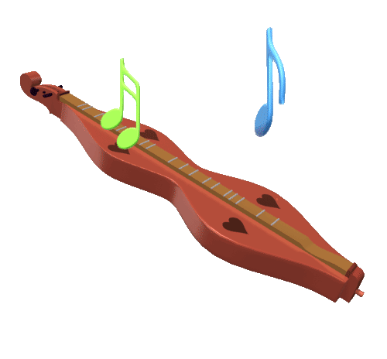
Musical intelligence
People with Musical intelligence recognize sounds and tones with ease

Slide 37
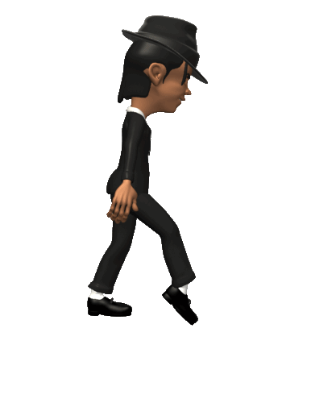

Musical intelligence
They appreciate music and rhythm

Slide 38

Musical intelligence
They have a "good ear" for music and can easily learn songs and melodies

Slide 39
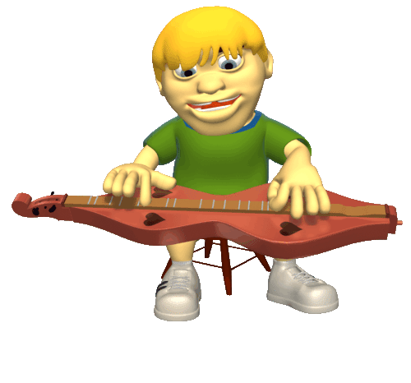
Musical intelligence
Some are especially gifted at composing, singing or playing an instrument

Slide 40
Possible careers
Choir Director
Composer
Conductor
Disc Jockey
Music Teacher
Musician
Record Producer
Singer
Songwriter
Sound Engineer

Slide 41

Naturalist intelligence
People with Naturalist intelligence have a sensitivity to and appreciation for nature

Slide 42
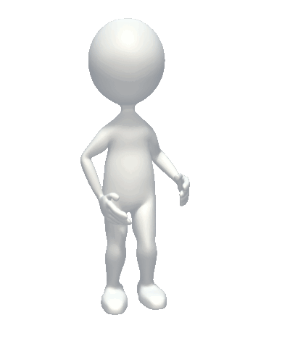

Naturalist intelligence
The Naturalist intelligence focuses on how people relate to their natural surroundings

Slide 43

Naturalist intelligence
Naturalists have a special ability to grow plants, vegetables and fruit

Slide 44

Naturalist intelligence
They have an affinity for animals and are good at training and understanding them

Slide 45


Naturalist intelligence
They are aware of and intrigued by weather phenomena

Slide 46
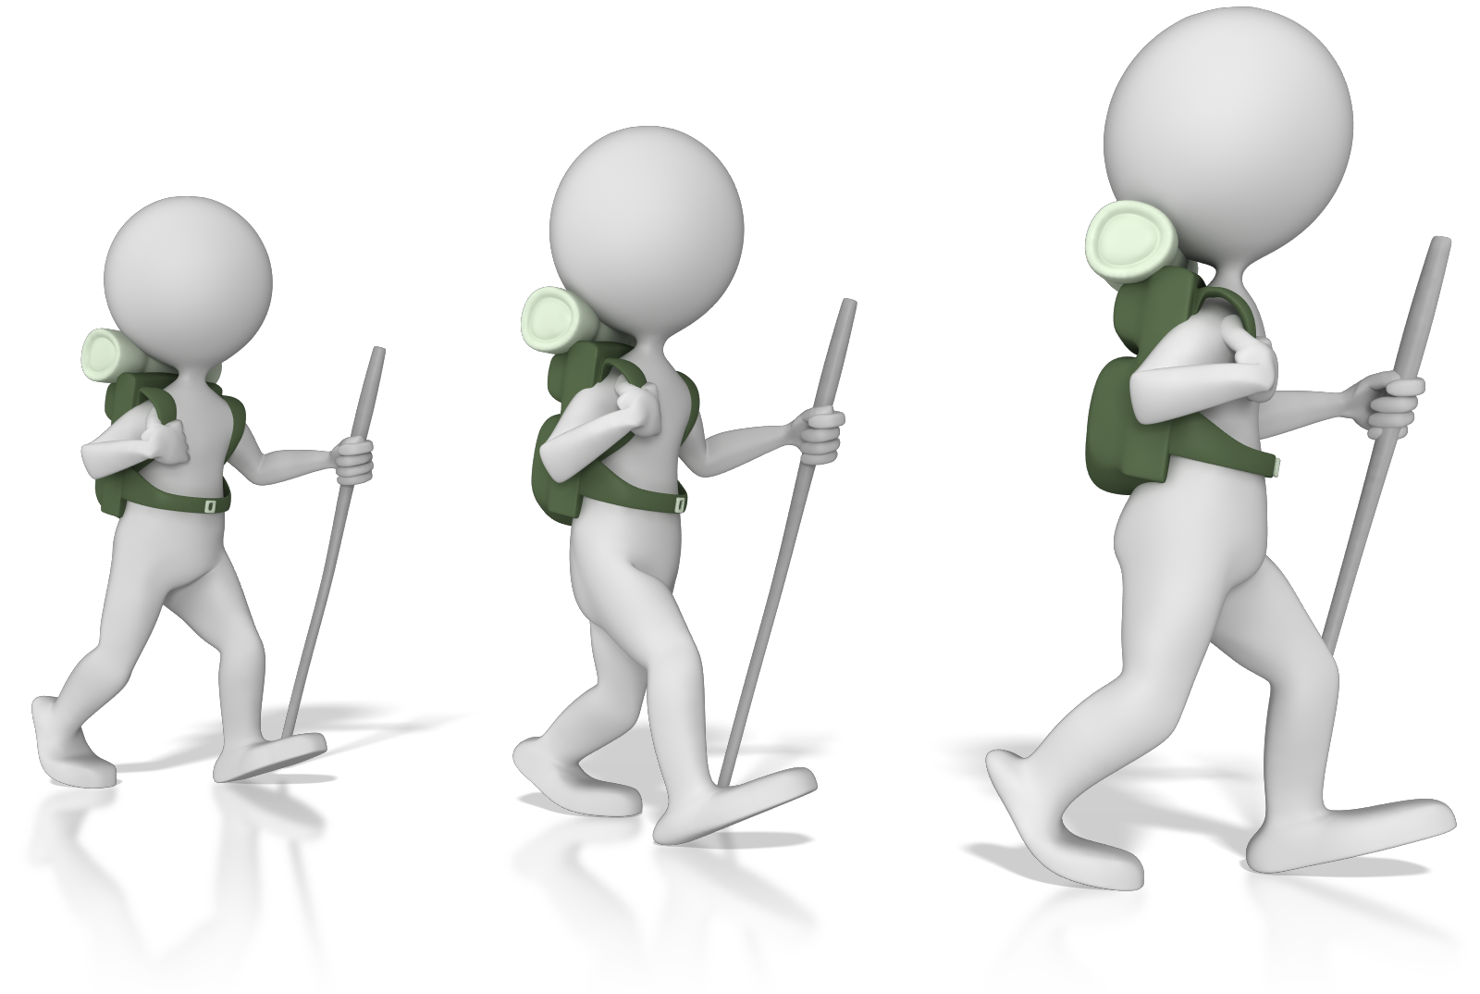
Naturalist intelligence
Naturalists love to walk, climb, camp and hike

Slide 47
Possible careers
Animal Trainer
Breeder
Farmer
Park Ranger
Geologist
Horticulturist
Landscaper
Marine Biologist
Veterinarian
Zookeeper

Slide 48

Logical intelligence
People with Logical intelligence process information through logic and reason

Slide 49
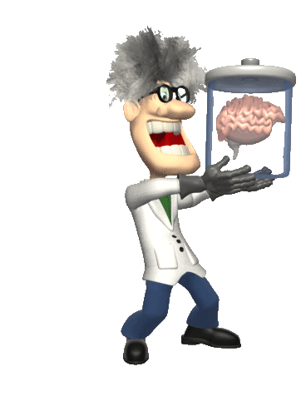
Logical intelligence
They are attracted to investigation by means of scientific methods

Slide 50

Logical intelligence
They do well with quantitative methods that rely on the researcher's ability to observe and reach a verifiable conclusion

Slide 51

Logical intelligence
They trust hard facts and numerical data
1+1=2
2+2=4
3+3=6
4+4=8

Slide 52

Logical intelligence
They seek accuracy and precision in their learning and work

Slide 53

Logical intelligence
Logical Intelligence thrives on mathematical models, measurements, abstractions and complex calculations

Slide 54
Possible careers
Accountant
Computer Programmer
Engineer
Financial Planner
Lawyer/Attorney
Mathematician
Medical Doctor
Military Officer
Scientist
Technical Writer

