Slide 1
Optimism
Positive Psychology

Slide 2
Optimism
Time: How long does things last?
Areas: Where in my life are things happening?
Me: How am I contributing to what happens in my life?

Slide 3

Optimism
Permanence (Time)
How long does things last?

Slide 4

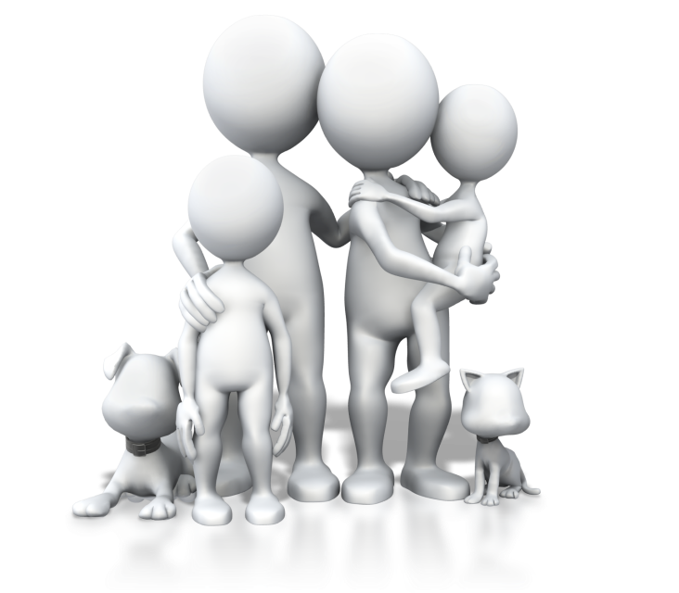

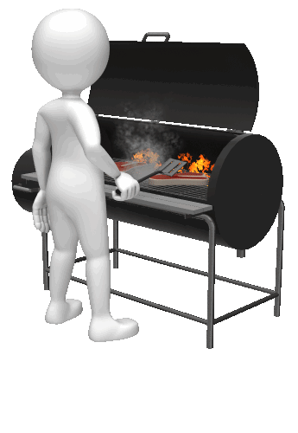
Optimism
Pervasiveness (Areas)
In what areas of my life are things happening?

Slide 5
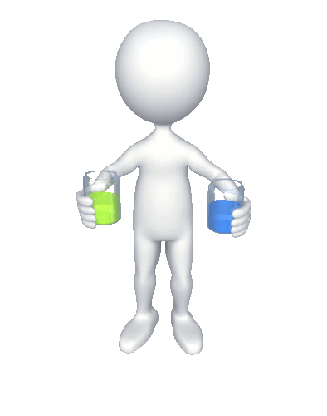
Optimism
Personalization (Self)
How do I contribute to what happens in my life?

Slide 6
Permanence
Good and Bad things in life
How long does bad things carry on in my life?
How long does good things carry on in my life?

Slide 7
Pervasive
Good and Bad things in life
Where does bad things happen in my life?
Where does good things happen in my life?

Slide 8
Personalization
Good and Bad things in life
How do I contribute to bad things in my life?
How do I contribute to good things in my life?

Slide 9
Optimist: Permanence
Good and Bad things in life
How long does bad things carry on in my life?
“Bad things are short lived, it’s temporary”
How long does good things carry on in my life?
“Good things last very long, it’s permanent”

Slide 10
Pessimist: Permanence
Good and Bad things in life
How long does bad things carry on in my life?
“Bad things last very long, it’s permanent”
How long does good things carry on in my life?
“Good things are short lived, it’s temporary”

Slide 11
Optimist: Pervasiveness
Good and Bad things in life
Where does bad things happen in my life?
“Bad things are only in this, it’s specific”
Where does good things happen in my life?
“Good things are everywhere, it’s universal”

Slide 12
Pessimist: Pervasiveness
Good and Bad things in life
Where does bad things happen in my life?
“Bad things are everywhere, it’s universal”
Where does good things happen in my life?
“Good things are only in this, it’s specific”

Slide 13
Optimist: Personalization
Good and Bad things in life
How do I contribute to bad things in my life?
“I am not the only cause of bad things in my life, it’s also external”
How do I contribute to good things in my life?
“I am the major cause of good things in my life, it’s internal”

Slide 14
Pessimist: Personalization
Good and Bad things in life
How do I contribute to bad things in my life?
“I am the major cause of bad things in my life, it’s internal”
How do I contribute to good things in my life?
“I am not the major cause of good things in my life, it’s external”

Slide 15
Permanence (Time)
Temporary vs Permanent
Optimist: “Good things are forever” and “Bad things are only temporary”
Pessimist: “Good things are temporary” and “Bad things are forever”

Slide 16
Permanence (Time)
PmB score
0 - 4 Optimistic
5 - 8 Pessimistic
PmG score
4 - 8 Optimistic
0 - 3 Pessimistic

Slide 17
Pervasiveness (Areas)
Specific vs Universal
Optimist: “Good things are everywhere” and “Bad things are only in this”
Pessimist: “Good things are only in this” and “Bad things are everywhere”

Slide 18
Pervasiveness (Areas)
PvB score
0 - 4 Optimistic
5 - 8 Pessimistic
PvG score
4 - 8 Optimistic
0 - 3 Pessimistic

Slide 19
Personalization (Self)
Internal vs External
Optimist: “I am the cause of good things” and “I am not the only cause of bad things”
Pessimist: “I am not the cause of good things” and “I am the major cause of bad things”

Slide 20
Personalization (Self)
PsB score
0 - 4 Optimistic
5 - 8 Pessimistic
PsG score
4 - 8 Optimistic
0 - 3 Pessimistic

Slide 21
B and G scores
B score
3 - 11 Optimistic
12+ Pessimistic
G score
14+ Optimistic
< 14 Pessimistic

Slide 22
Overall scores
Stuff of Hope score
(PvB + PmB)
0 - 8 hopeful
9 - 16 less hopeful
G minus B score
3+ optimistic
< 3 pessimistic

