Slide 1
PERSONALITY
Balance life coach training

Slide 2
Introduction
The four questions
Where do you focus?
How do you gather information or develop insight?
How do you make decisions?
What is your preferred lifestyle?

Slide 3
The Scale
E
0
I
25
25
Extrovert
Introvert
S
N
0
25
25
Sensing
Intuition

Slide 4
The Scale
T
0
F
25
25
Thinking
Feeling
J
P
0
25
25
Judging
Perceiving

Slide 5
The 1st Scale
Where do you focus?
E
0
I
25
25
Extrovert
Introvert

Slide 6
The 2nd Scale
How do you gather information?
S
0
N
25
25
Sensing
Intuition

Slide 7
The 3rd Scale
How do you make decisions?
T
0
F
25
25
Thinking
Feeling

Slide 8
The 4th Scale
What is your preferred lifestyle?
J
0
P
25
25
Judging
Perceiving

Slide 9

The 1st Scale
Where do you focus?
E
0
I
25
25
Extrovert
Introvert

Slide 10
Extrovert
Extroverts (E) focus on the world ‘out there’, the world of people and other things

Slide 11
Introvert
Introverts (I) focus on their own inner world of thoughts and ideas

Slide 12

The 2nd Scale
How do you gather information?
S
0
N
25
25
Sensing
Intuition

Slide 13
Sensors
Sensing (S) personality types gather information primarily through their five physical senses

Slide 14
Intuition
Intuitives (N) gather information by observing patterns and possibilities rather than the physically observable information

Slide 15

The 3rd Scale
How do you make decisions?
T
0
F
25
25
Thinking
Feeling

Slide 16
Thinking
Thinking (T) types make decisions based on logical, impersonal analysis

Slide 17
Feeling
Feeling (F) types make decisions based on personal concerns and the people involved

Slide 18
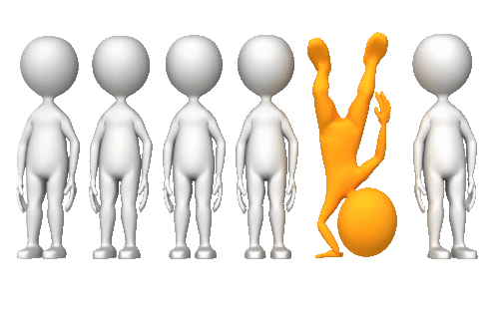
The 4th Scale
What is your preferred lifestyle?
J
0
P
25
25
Judging
Perceiving

Slide 19
Judging
Judging (J) types prefer a structured and organized lifestyle

Slide 20
Perceiving
Perceiving (P) types prefer a spontaneous and open-ended lifestyle

