Slide 1
Six Thinking Hats
Innovative Leadership

Slide 2
6 Hats
White hat
Red hat
Black hat
Green hat
Yellow hat
Blue hat

Slide 3


White Hat
Neutral, un-emotional, factual thinking

Slide 4

The White Hat
(Facts and Figures)
Just give the facts in a neutral, realistic and unemotional manner
Never mind the interpretation, just the facts please!
What are the facts in this matter?

Slide 5

Red Hat
Emotional thinking

Slide 6

The Red Hat
(Emotions and Feelings)
Opposite of neutral, objective, realistic information
Hunches, emotions, intuitions and impressions
No need to justify or give reasons
How do you really feel about this?

Slide 7

Black Hat
Negative thinking

Slide 8

The Black Hat
(What is wrong with it?)
The logical in a negative way
Critical judgement
The pessimistic view
What is negative about this?

Slide 9

Green Hat
Innovation, creativity and new ideas

Slide 10

The Green Hat
(Creative & lateral thinking)
The creation of new ideas & different alternatives
Green hat thinking is practical thinking
New approaches to solve problems
How can we address, change or resolve this issue?

Slide 11

Yellow Hat
Possibility thinking

Slide 12
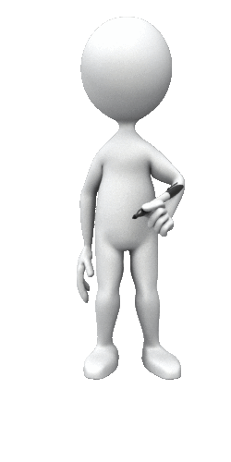
The Yellow Hat
(Positive possibilities)
Positive thinking - optimism
Yellow hat thinking focuses on benefits & the good stuff
How can we practically resolve the issue?

Slide 13

Blue Hat
Bigger picture thinking

Slide 14

The Blue Hat
(Bigger picture)
Thinking about thinking
Instructions & organisation for thinking
Bigger picture thinking
How does the issue relate to everything else?

Slide 15

Questions
White hat: What are the facts?
Red hat: How do you feel about this?
Black hat: What is negative about this?
Green hat: How can this issue be resolved, addressed or changed?
Yellow hat: What are the positive possibilities about this?
Blue hat: What is the ‘bigger picture’ of this issue?

