Slide 1





Maslow’s hierarchy of needs
Physiological
Security
Belonging
Self worth
Self actualisation

Slide 2
Maslow’s hierarchy of needs
Physiological
Security
Belonging
Self worth
Self actualisation

Slide 3
Maslow’s hierarchy of needs
Physiological
Basic life needs - air, food,
drink, shelter, warmth,
sex, sleep, etc.

Slide 4
Maslow’s hierarchy of needs
Physiological
Security
Belonging
Self worth
Self actualisation

Slide 5
Maslow’s hierarchy of needs
Security
Protection from elements, security, order, law, limits, stability, etc.

Slide 6
Maslow’s hierarchy of needs
Physiological
Security
Belonging
Self worth
Self actualisation

Slide 7
Maslow’s hierarchy of needs
Belonging
Work group, teams, family, affection, relationships, etc.

Slide 8
Maslow’s hierarchy of needs
Physiological
Security
Belonging
Self worth
Self actualisation

Slide 9
Maslow’s hierarchy of needs
Self worth
Self-esteem, achievement, mastery, autonomy, status, responsibility, etc.

Slide 10
Maslow’s hierarchy of needs
Physiological
Security
Belonging
Self worth
Self actualisation

Slide 11
Maslow’s hierarchy of needs
Self actualisation
Realising personal potential, self-fulfilment, seeking personal growth and peak experiences

Slide 12
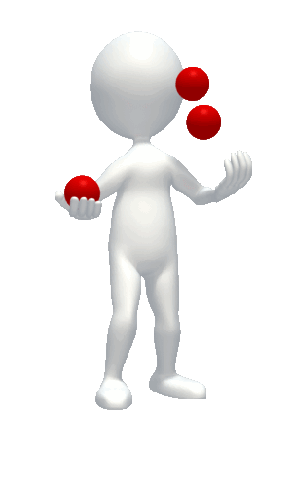
Self actualisation characteristics
Self actualising people see things for what they are & not what they want them to be
They make realistic judgements, rather than take things too personal
They see problems in terms of challenges rather than seeing problems as reasons for personal complaints or excuses
They have a need for privacy and are comfortable being by themself

Slide 13
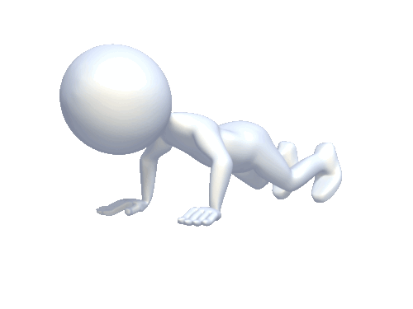
Self actualisation characteristics
They are not susceptible to social pressures – they are non-conformists
They are democratic, fair & non-discriminating
They are socially compassionate
They possess kindness towards humanity
They are comfortable with themselves, despite having unique tendencies

Slide 14
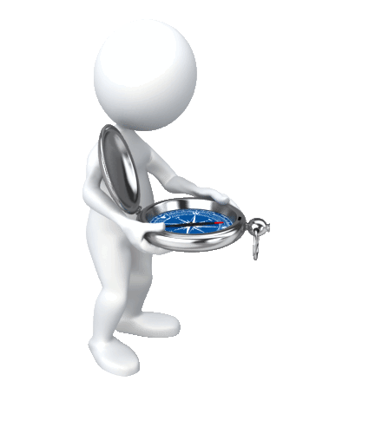
Self actualisation characteristics
They have a few close intimate friends rather than many ‘surface’ friends
They have a sense of humour directed at themselves & not at ridiculing others
They are spontaneous & natural
They are true to themselves
They are excited & interested in everything, even ordinary things

Slide 15
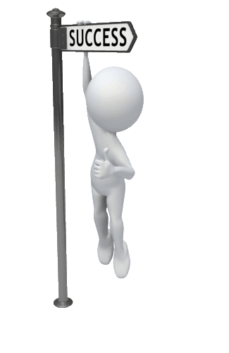
Self actualisation characteristics
They live lives of thankfulness
They accept others as they are
They are creative, inventive and original
They are not reliant on their culture & environment to form their opinions & views for them
They seek ‘peak experiences’ that leave a lasting impression

